Slide 1

AERO-TRAN
Flight Booking

Slide 2
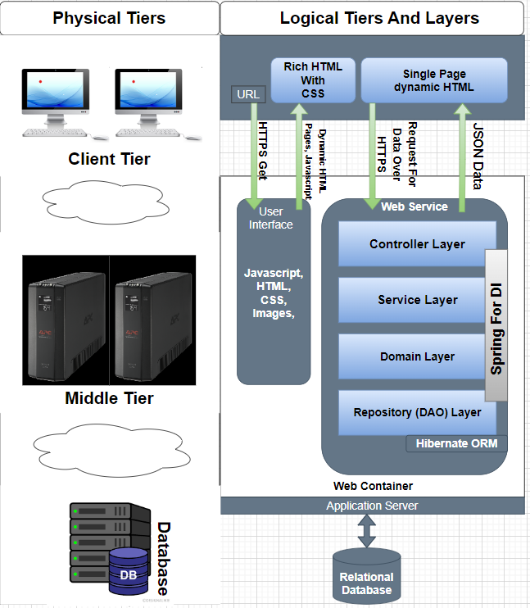
A Monolithic application built using - Spring MVC Thymeleaf MySQL Database

Slide 3

Features
For Admins:
Add new airports to our network, ensuring easy travel to more destinations.
Schedule new flights, update details, and even remove flights when needed.
For Users:
Find your perfect flight with our powerful search tool. Explore destinations, filter by dates, and compare options.
See all available flights for your chosen route, with clear information on departure times, airlines, and prices.
Secure your flight with ease using our user-friendly booking system.
Cancel your flight or view booking details all in one place.

Slide 4
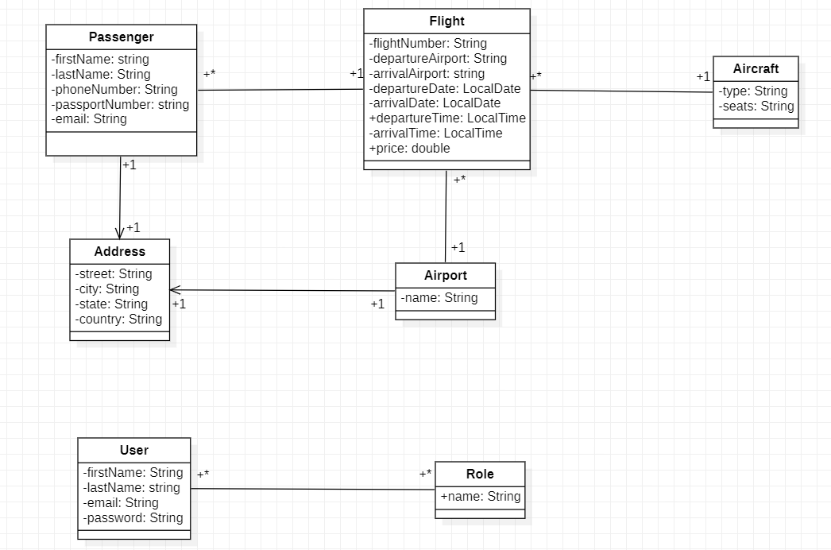
Class Diagram

Slide 5
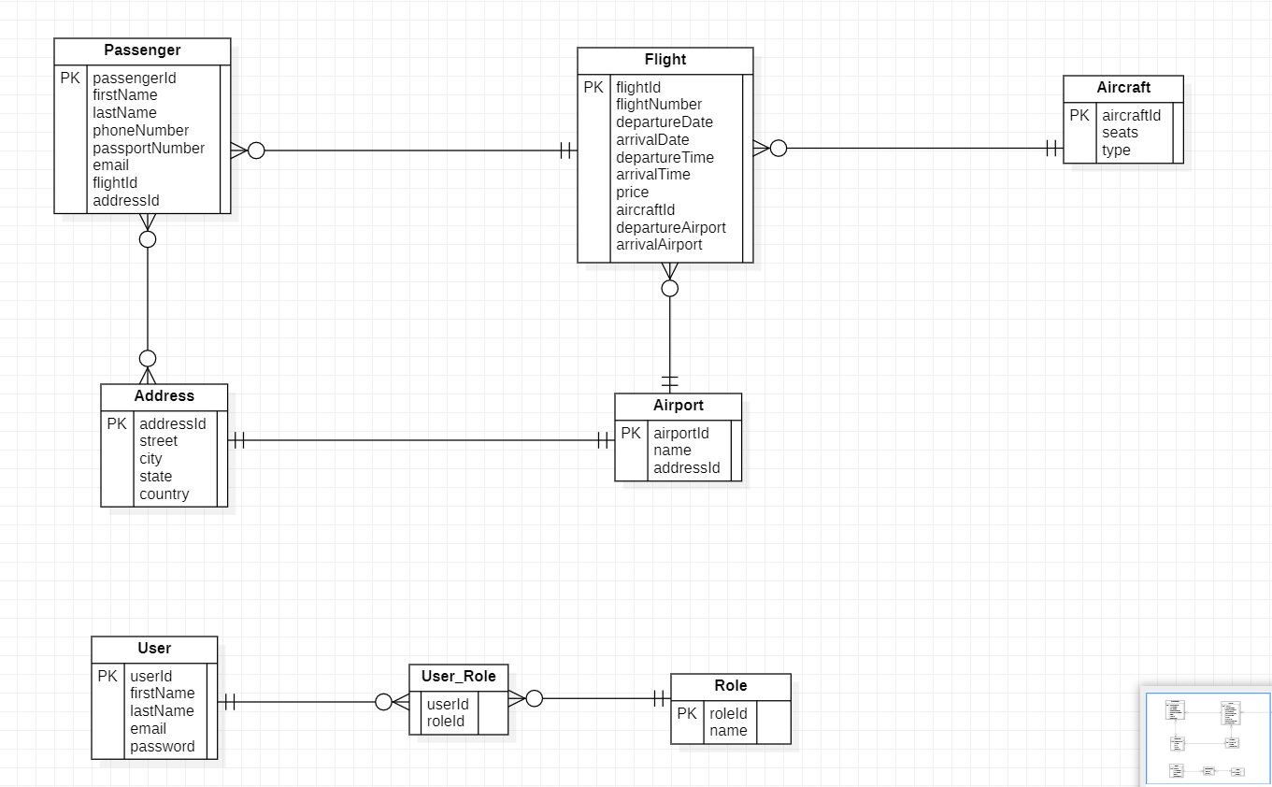
ER-Diagram

Slide 6
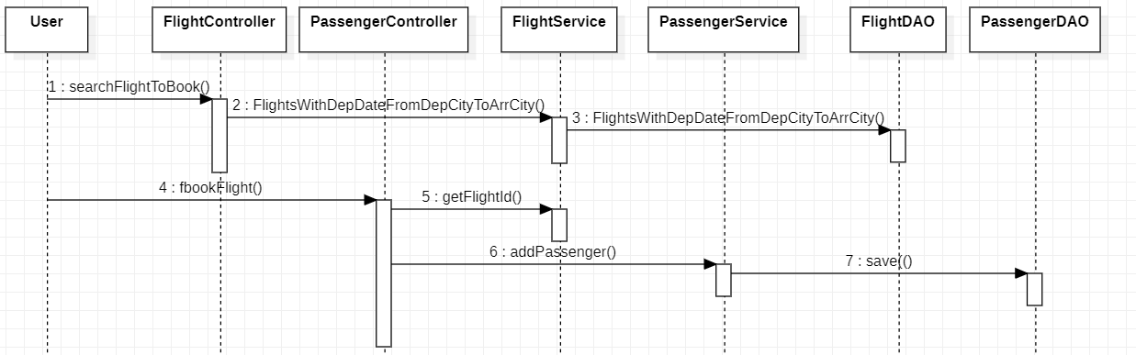
Sequence Diagram – Book a Flight

